Slide 1


Database
Management
SMILE Portal Database

Slide 2
Our Team Infographics
Deepak Kumar
21CSB0B13
Kapil Dev
21CSB0B27

Slide 3
01
Problem Statement

Slide 4


PROBLEM STATEMENT
In this Project SMILE PORTAL REGISTRATIONS , we aim to build a database management system to store the data of students such as backlog subjects , semester registrations of the college .
We are building the model in such a way that it will help students to know about the allotted faculties , CGPA , backlog subjects , Hostels , Fees Payment , Department .

Slide 5
Schema
Users (user_id PK, username, password)
Students (student_id PK, user_id FK, first_name, last_name, address) ContactDetails (student_id PK FK, email, phone)
Hostels (hostel_id PK, name, capacity, available_rooms)
Fees (fee_id PK, student_id FK, amount, status)
Courses (course_id PK, name, department, credits)
Grades (grade_id PK, student_id FK, course_id FK, grade)
Semesters (semester_id PK, name, start_date, end_date)
Faculty (faculty_id PK, first_name, last_name, email, phone, department)

Slide 6
02
Entity- Relationship
Diagram

Slide 7
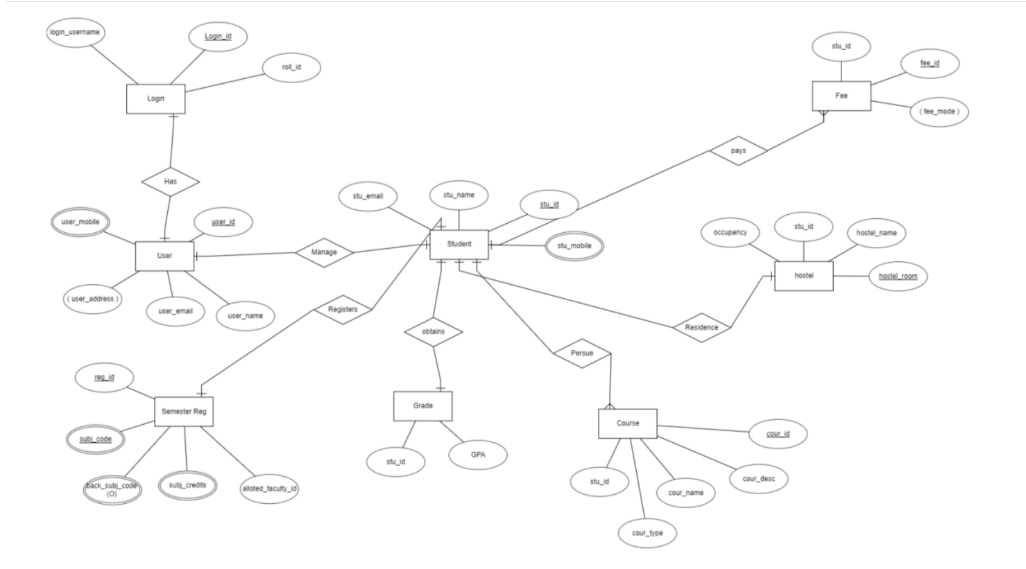
E-R DIAGRAM

Slide 8
03
Table Structure

Slide 9
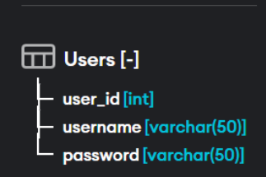
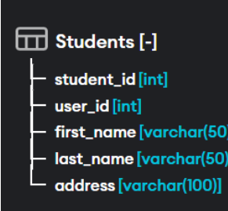

Slide 10
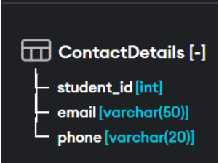
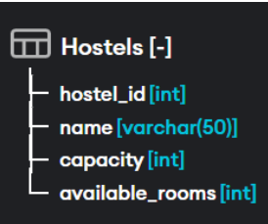
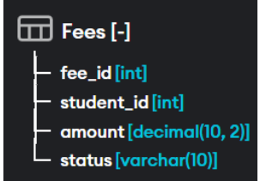
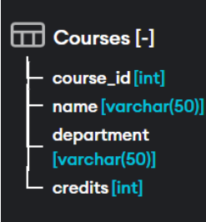

Slide 11
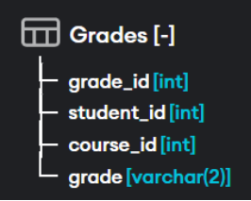
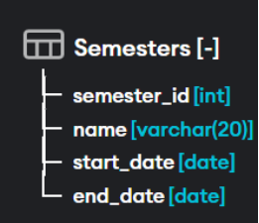
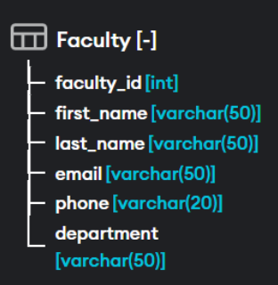

Slide 12
04
Functional Dependencies

Slide 13
Functional Dependency
Users table: user_id -> username, password
Students table: student_id -> user_id, first_name, last_name, email, phone, address
Hostels table: hostel_id -> name, capacity, available_rooms
Fees table: fee_id -> student_id, amount, status
Courses table: course_id -> name, department, credits
Grades table: grade_id -> student_id, course_id, grade
Semesters table: semester_id -> name, start_date, end_date
Faculty table: faculty_id -> first_name, last_name, email, phone, department

Slide 14
NORMALIZATION
Step 1: Convert repeating groups to separate tables. We can see that the Students table has a repeating group for email and phone. We'll move those attributes to a separate table called ContactDetails
.
CREATE TABLE ContactDetails
( student_id INT,
email VARCHAR(50) NOT NULL,
phone VARCHAR(20) NOT NULL,
PRIMARY KEY (student_id),
FOREIGN KEY (student_id) REFERENCES Students(student_id)
);

Slide 15
NORMALIZATION
Step 2: Remove partial dependencies and create separate tables. We can see that the Students table has a partial dependency on user_id. To remove this dependency, we'll create a separate table called Users with the user_id, username, and password.
CREATE TABLE Users
( user_id INT PRIMARY KEY,
username VARCHAR(50) NOT NULL,
password VARCHAR(50) NOT NULL
);

Slide 16
NORMALIZATION
Step 3: Create separate tables for many-to-many relationships. We can see that the Grades table represents a many-to-many relationship between students and courses. To handle this, we'll create a separate table called StudentCourses.
CREATE TABLE StudentCourses
( student_id INT,
course_id INT,
grade VARCHAR(2) NOT NULL,
PRIMARY KEY (student_id, course_id),
FOREIGN KEY (student_id) REFERENCES Students(student_id),
FOREIGN KEY (course_id) REFERENCES Courses(course_id)
);

Slide 17

Thank you!

